Slide 1
Test Automator

Slide 2
Agenda
Automators
Features
Test Automator
Design
Advantages

Slide 3
Automators
Software developed to automate repetitive tasks
Perform different actions automatically
Develop well designed and fully tested artifacts.

Slide 4
Features
Creates test data templates, test report templates and validation script
Identifies and creates default test cases
save script debug time
Scalable to add or remove features

Slide 5
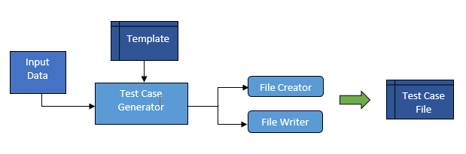
Test Case Generator
Initial implementation

Slide 6
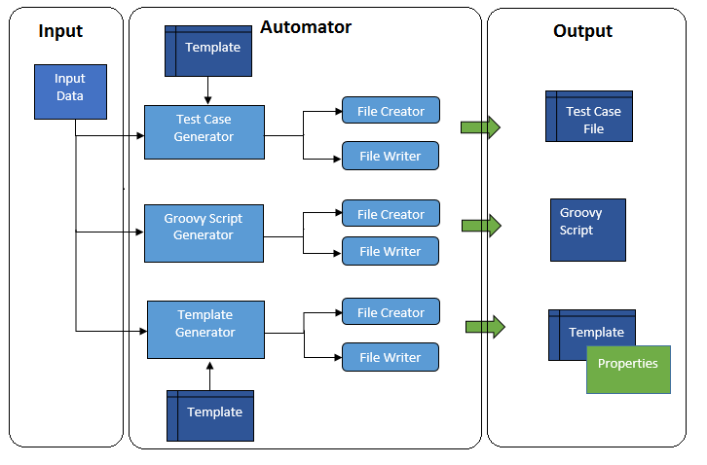
Test Automator

Slide 7
Test Automator Output
Test cases with sample data
Validation groovy script
Template files
Test data template
Test report template
Property files

Slide 8
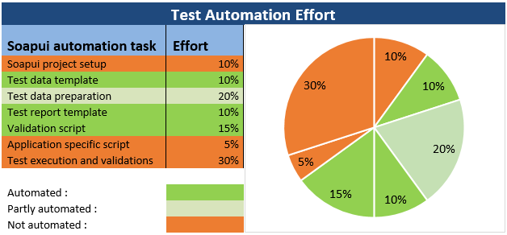
Efforts

Slide 9
Advantages
Save manual effort of creating test data template, test report template and script.
Save script debug time
Quick change/modifications
Reduces half of the manual effort.

Slide 10
Thank You

Slide 11

Questions

